Slide 1
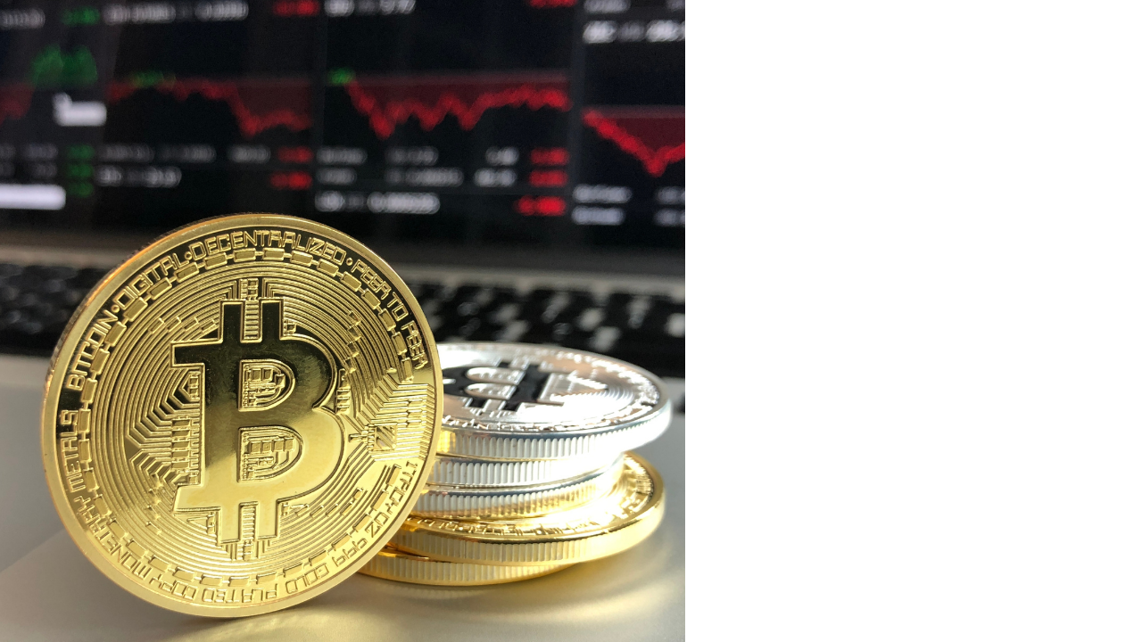

Slide 2
Contents of Blockchain
Introduction of Blockchain?
Distributed P2P Networks
Immutable Ledger
How does it works
Hashing Algorithm
Applications of Blockchain
Why Blockchain
What is Mining?
Advantages and Disadvantages

Slide 3
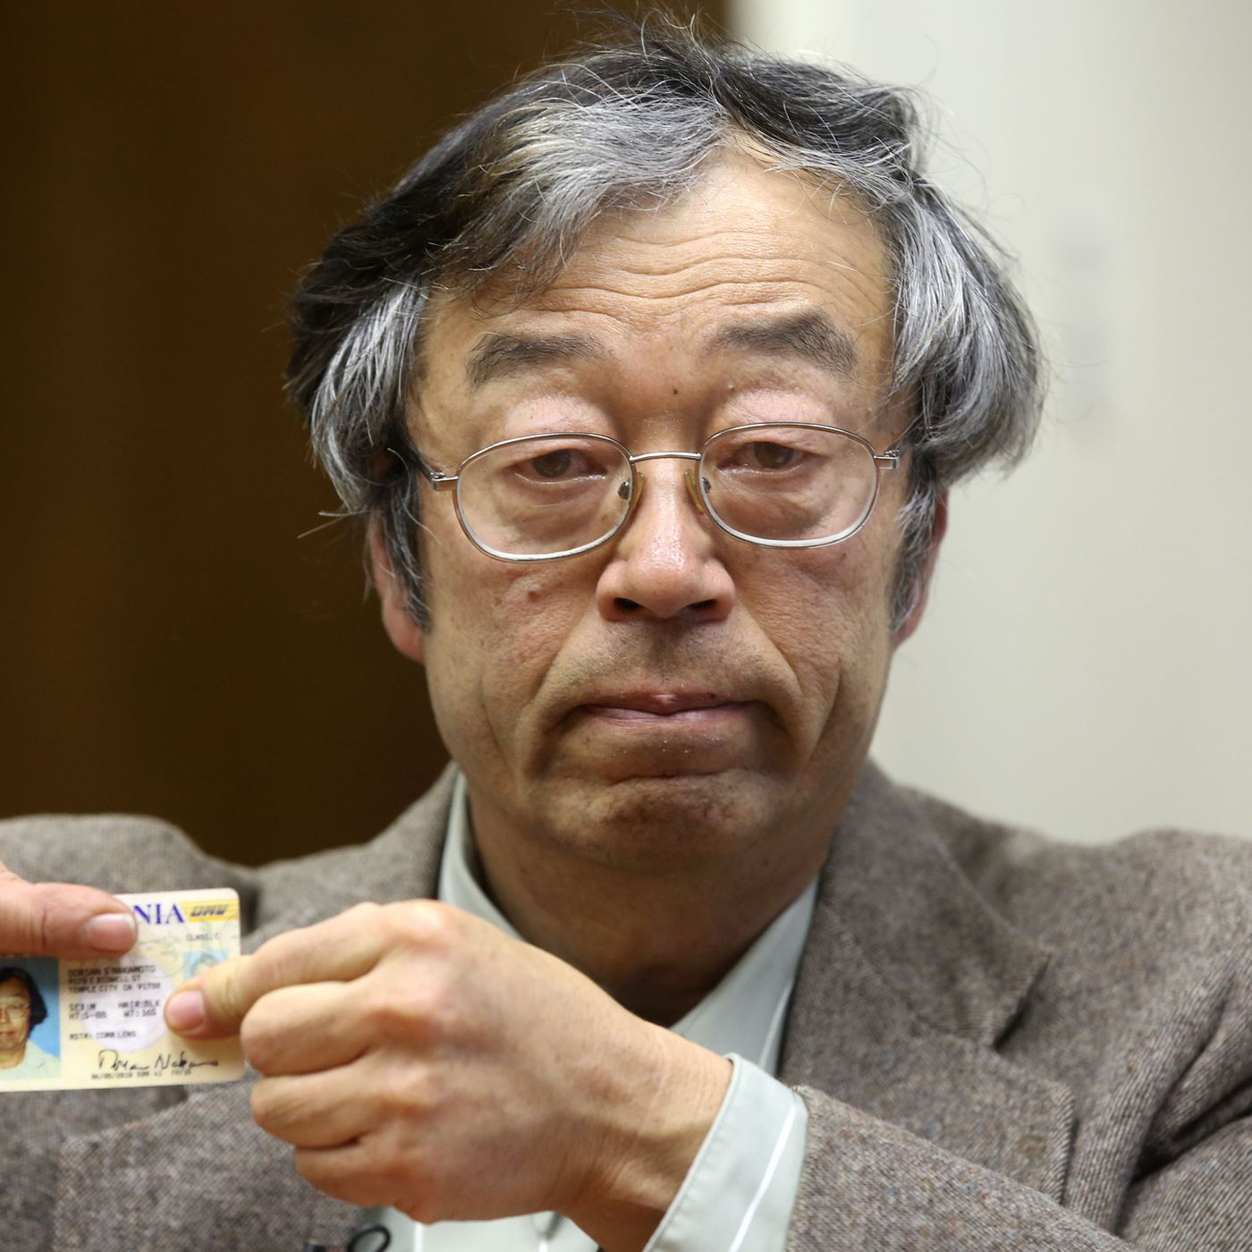
Introduction
First proposed as a research project in 1991.
The blockchain is invented by anonymous developer SHATOSHI NAKAMOTO in 2009.

Slide 4
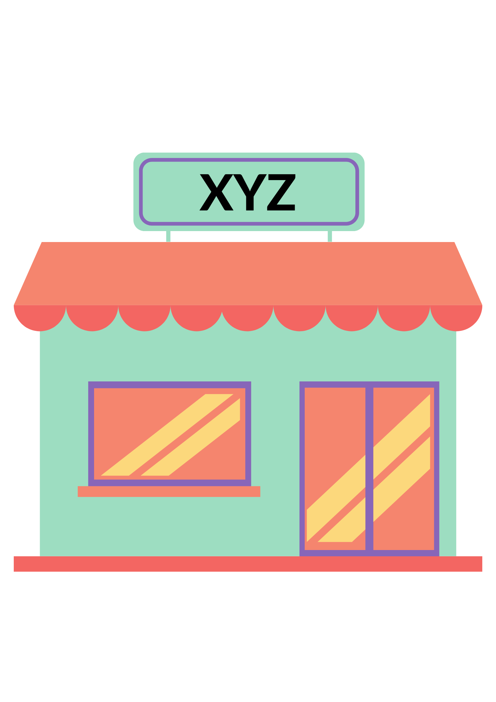
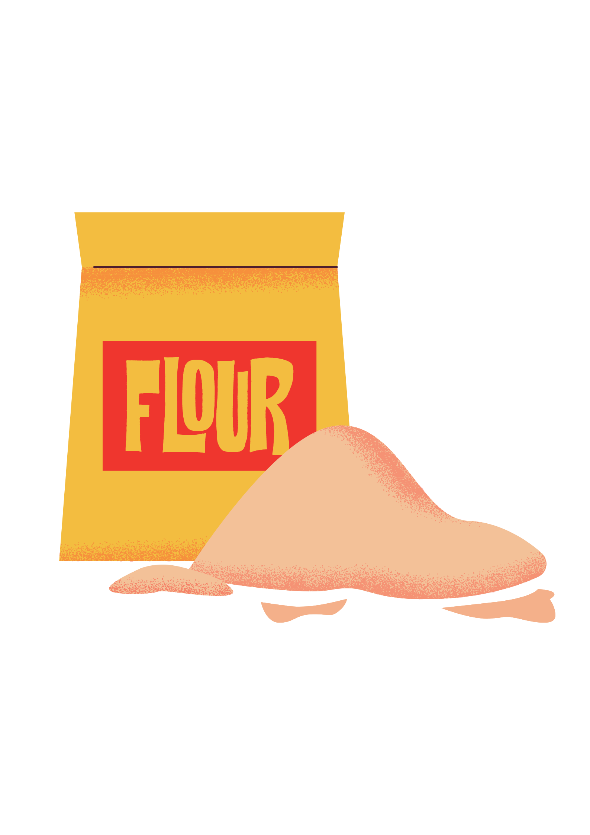
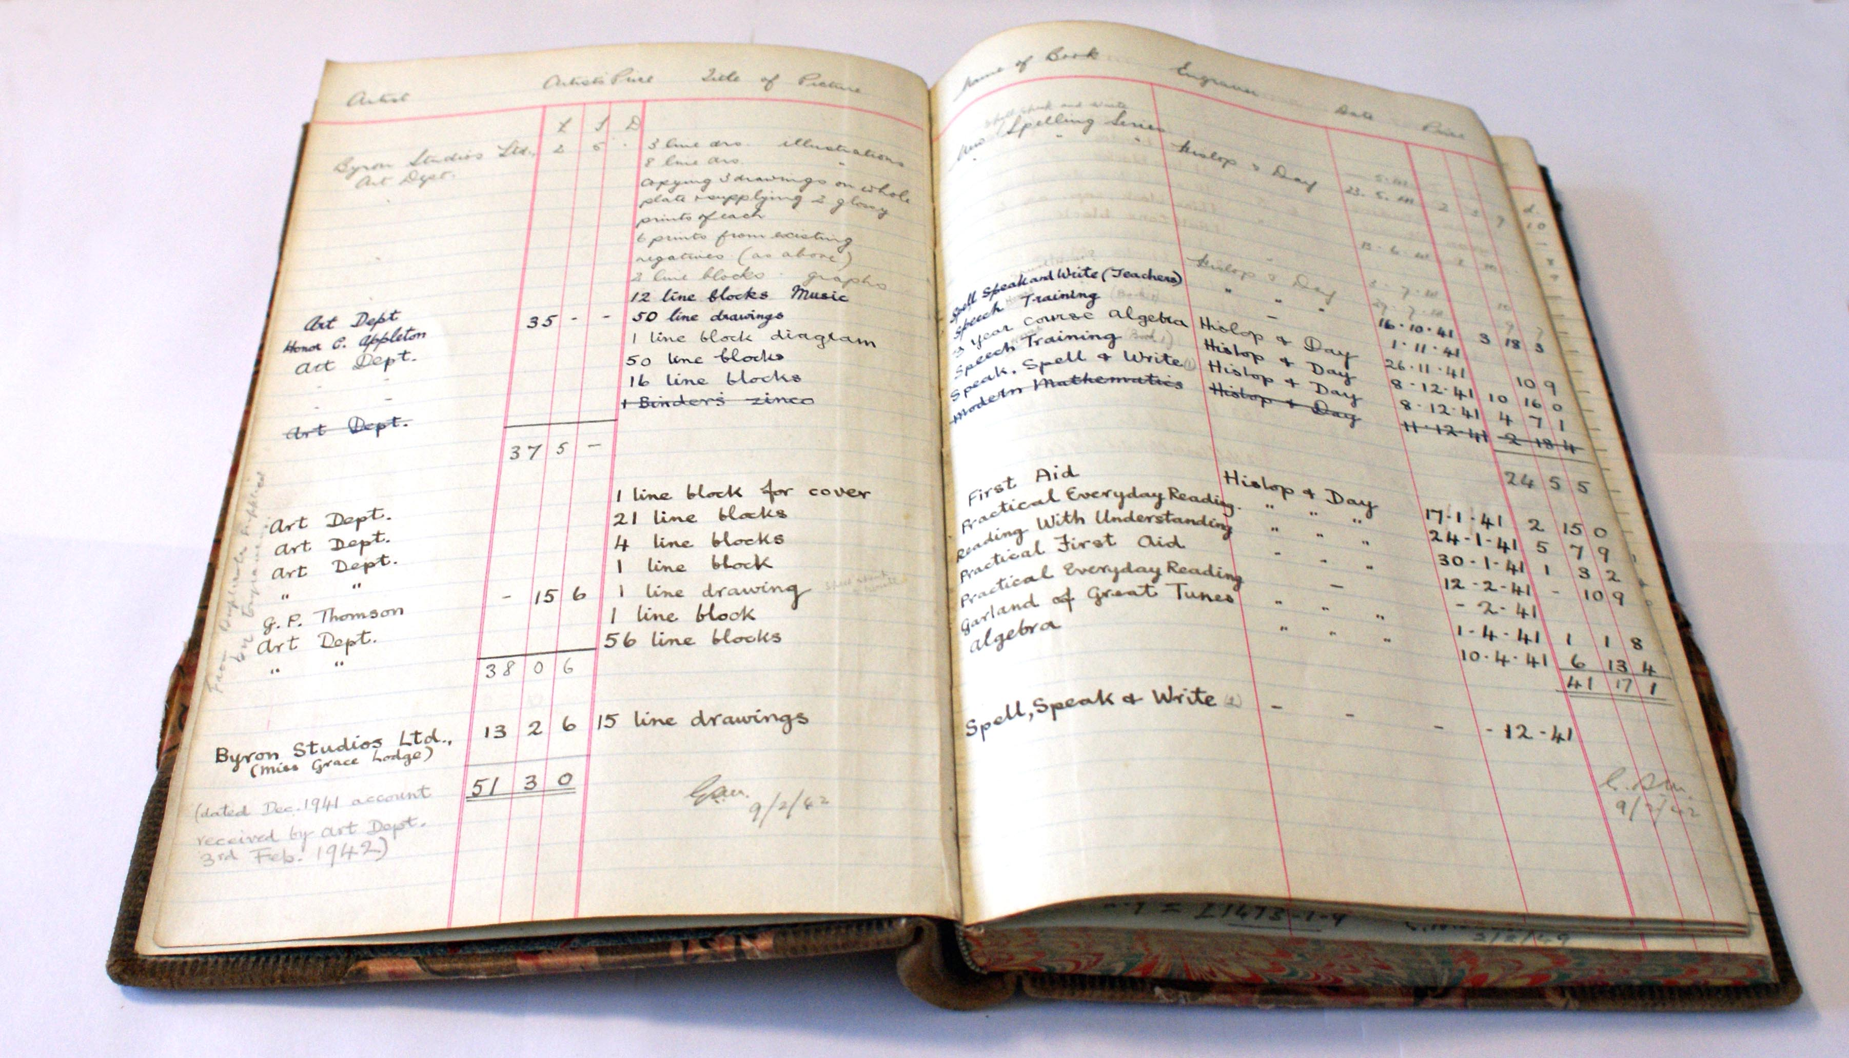

How does Blockchain is works?
Entry
Ledger Book

Slide 5
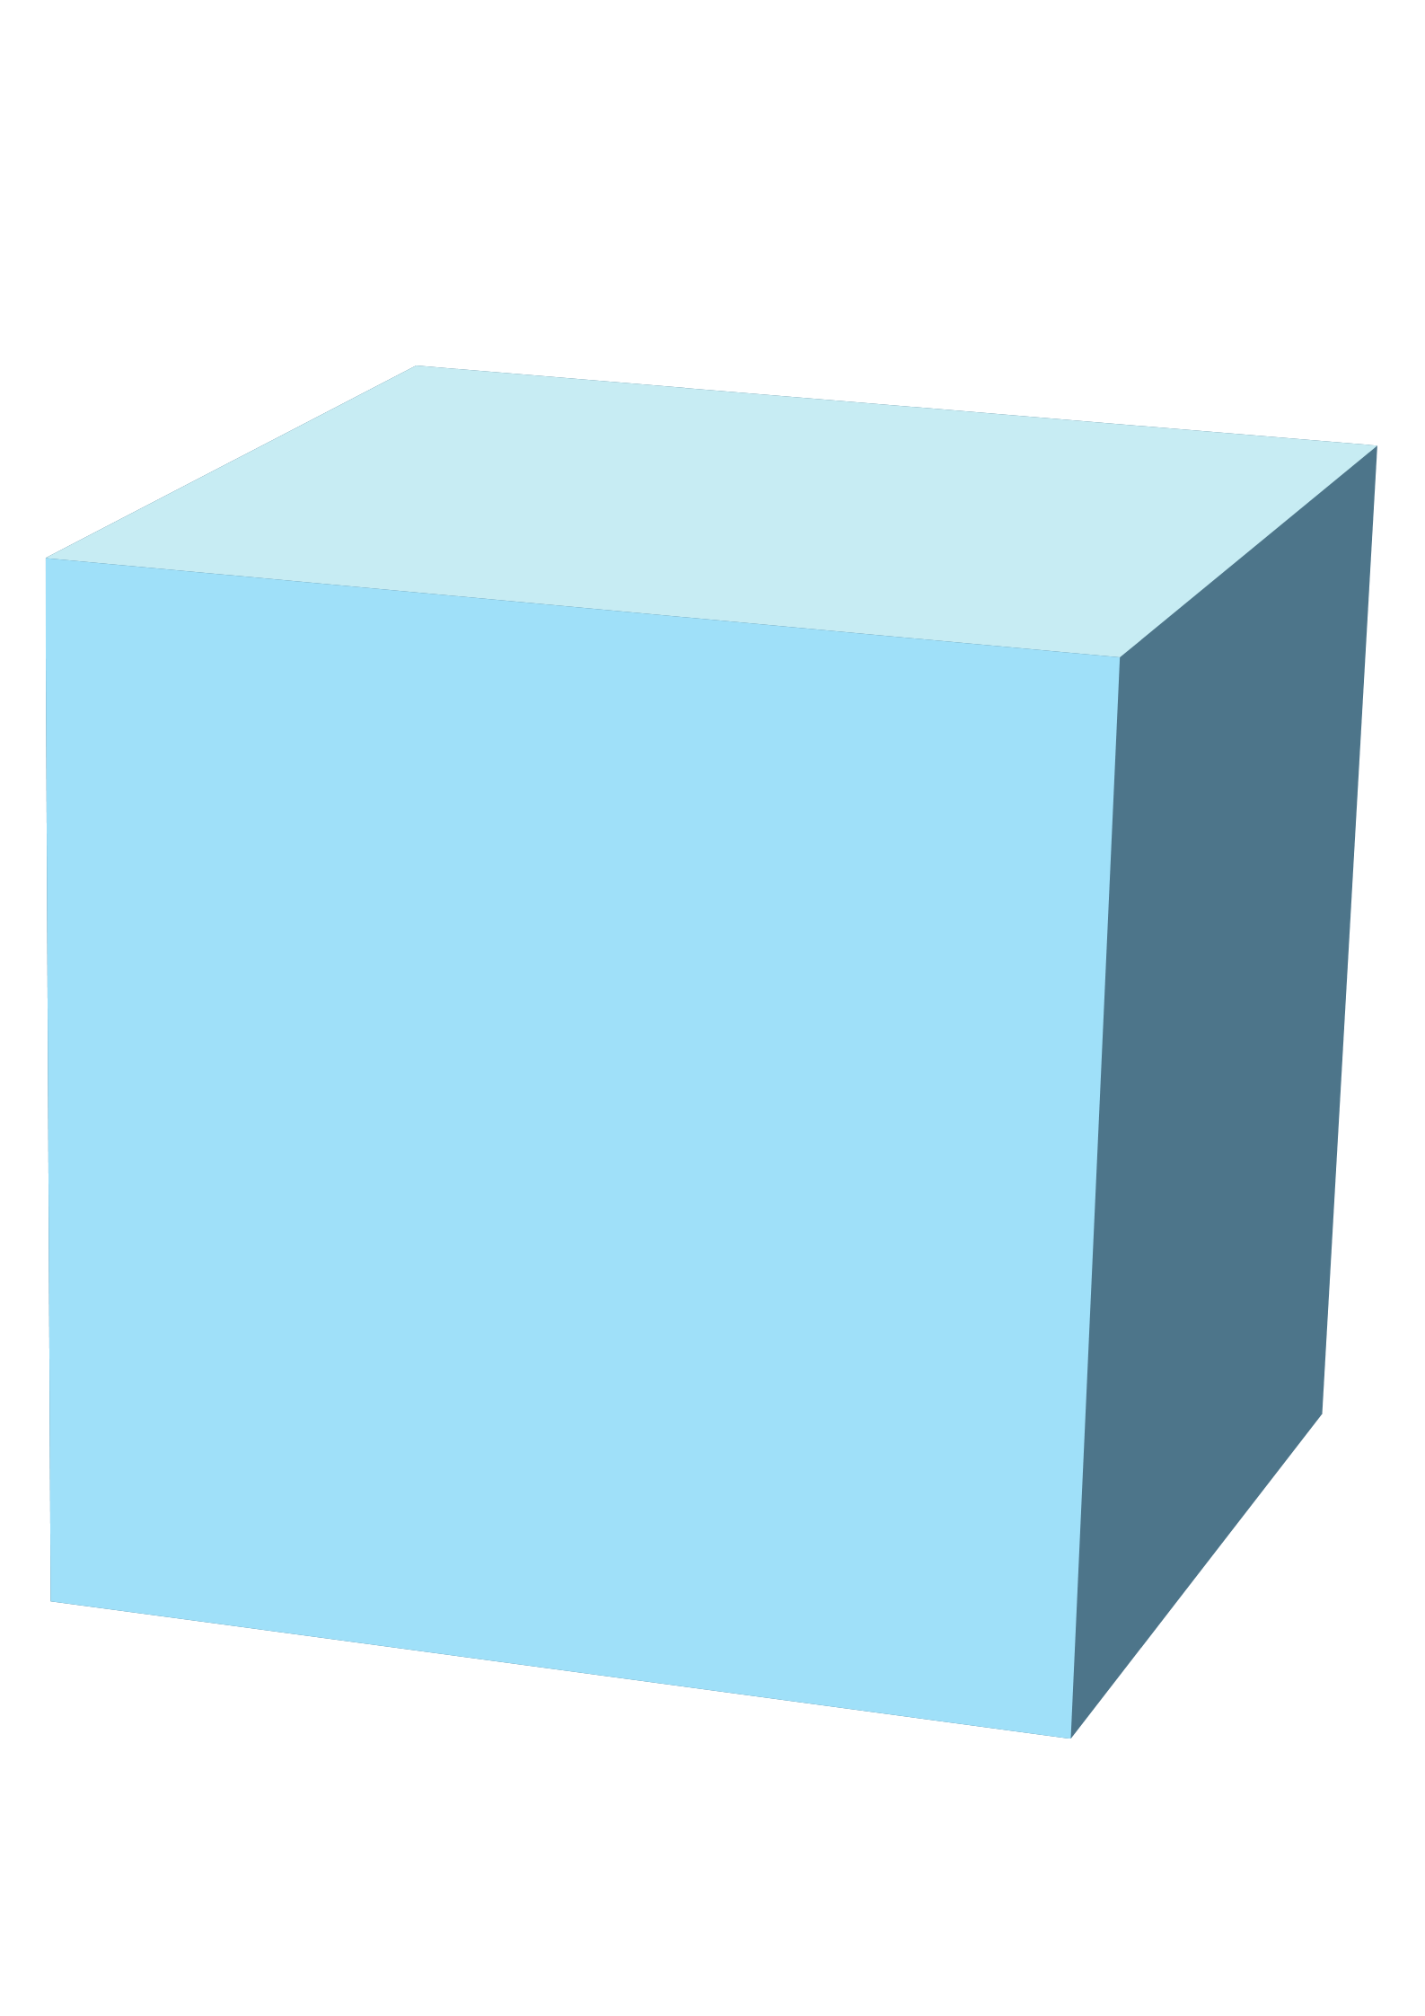

How does Blockchain is works?
Blockchain is a distributed immutable ledger which is completely transparent.

Slide 6
How does Blockchain is works?
Ledger Book
Block

Slide 7

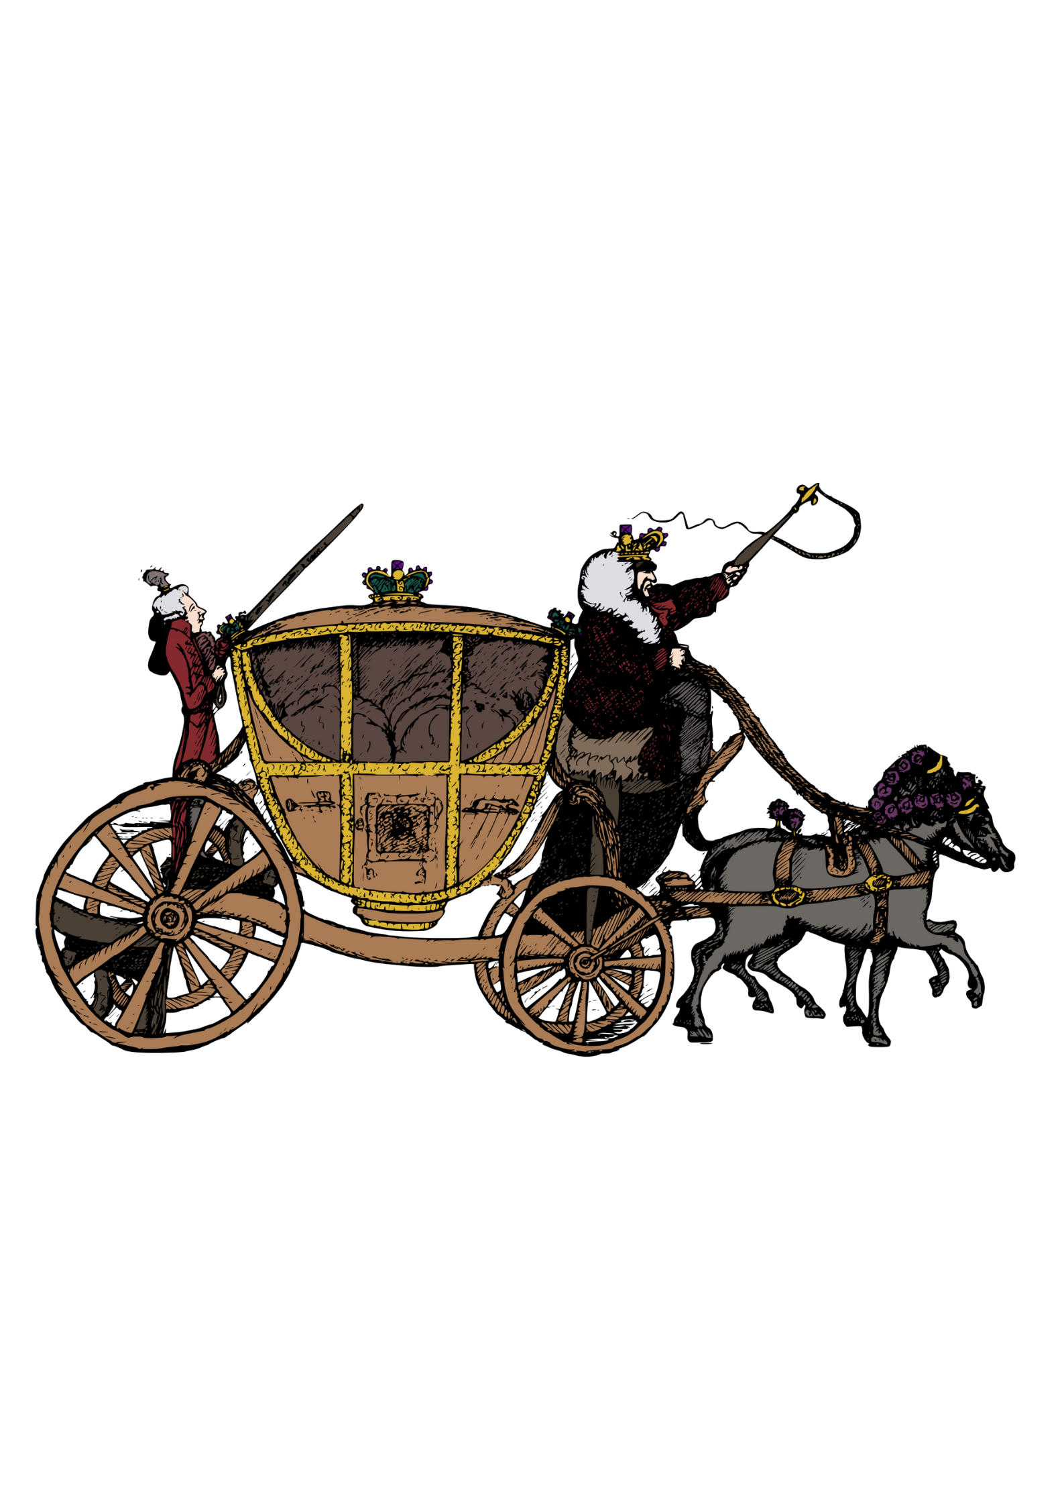
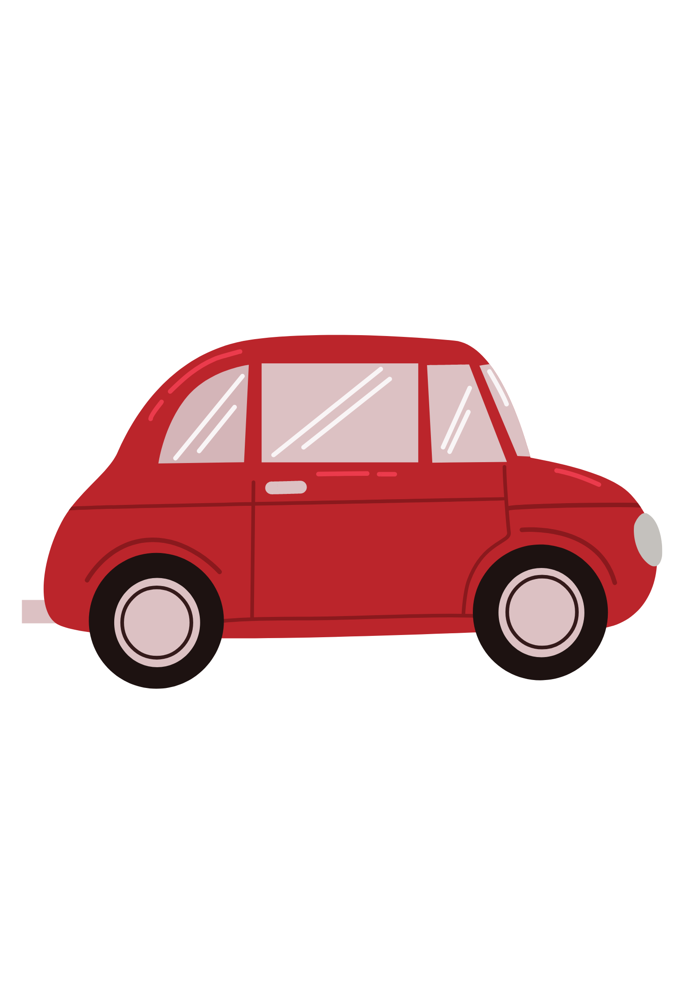
Why Blockchain?
Because Blockchain is a disruptive technology.
Q) What is a disruptive technology?

Slide 8


Why Blockchain?
Internet:
Blockchain:
Internet Communication
Blockchain Trust

Slide 9
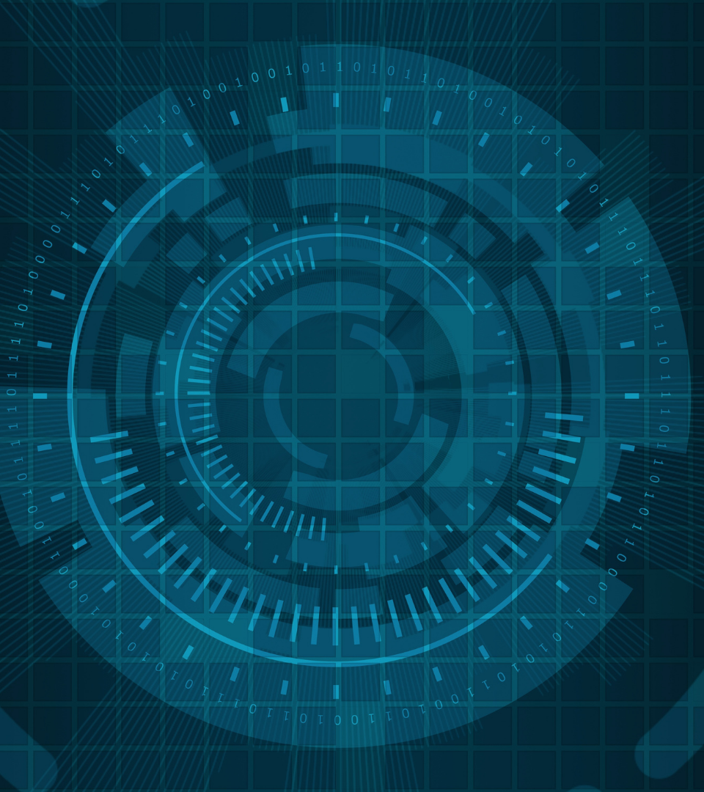
Distributed P2P network in Blockchain

Slide 10

Distributed P2P network
A
B
E
F
C

Slide 11


Distributed P2P network
Hacker Attacks
Corrupted
A
B
C
D
E
F
Concept of Immutability

Slide 12

Distributed P2P network
A
B
E
F
C

Slide 13
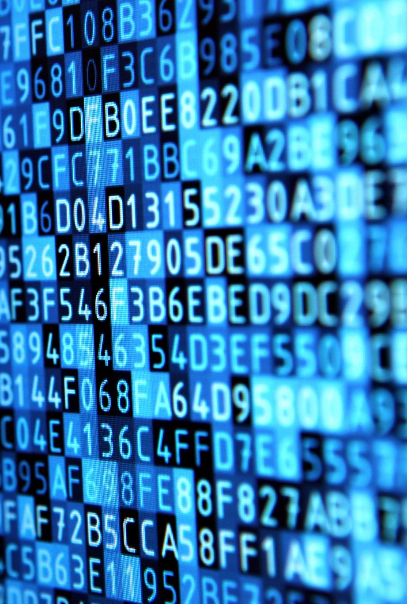
Hashing Algorithm

Slide 14
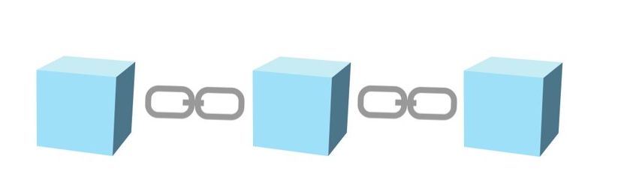
Hashing Algorithm
Block No.-1
Data
Prev Hash:000000000
Hash:0000D8C42
Block

Slide 15

Hashing Algorithm
Block No.-1
Data
Prev Hash:000000000
Hash:0000D8C42
Fingerprint
Block

Slide 16
Hashing Algorithm
Block No.-1
Block No.-2
Data
Data
Prev Hash:000000000
Prev Hash:
Hash:0000D8C42
Hash:00003A459

Slide 17
Hashing Algorithm
Block No.-1
Block No.-2
Block No.-3
Data
Data
Data
Prev Hash:000000000
Prev Hash:0000D8C42
Prev Hash:00003A459
Hash:0000D8C42
Hash:00003A459
Hash:00003D45F
Genesis Block

Slide 18
Hashing Algorithm
The five requirements of Hash Algorithm-
One Way
Encrypted
Data
Withstand Collisions
Data
Deterministic
Avalanche Effect
ABC
845
Fast Computation

Slide 19


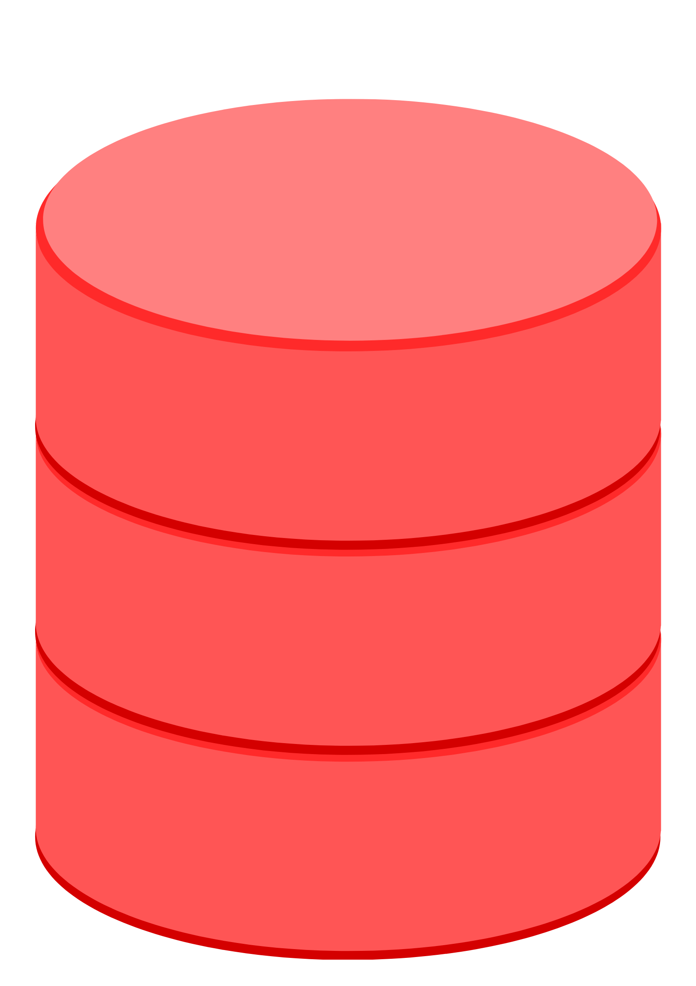
Immutable Ledger
Immutable ledger in blockchain refers to any records that have the ability to remain unchanged. It cannot be altered and hence the data cannot be changed with ease, thereby making sure that the security is quite tight.
Maintain Register
Centralized Database
Institution

Slide 20
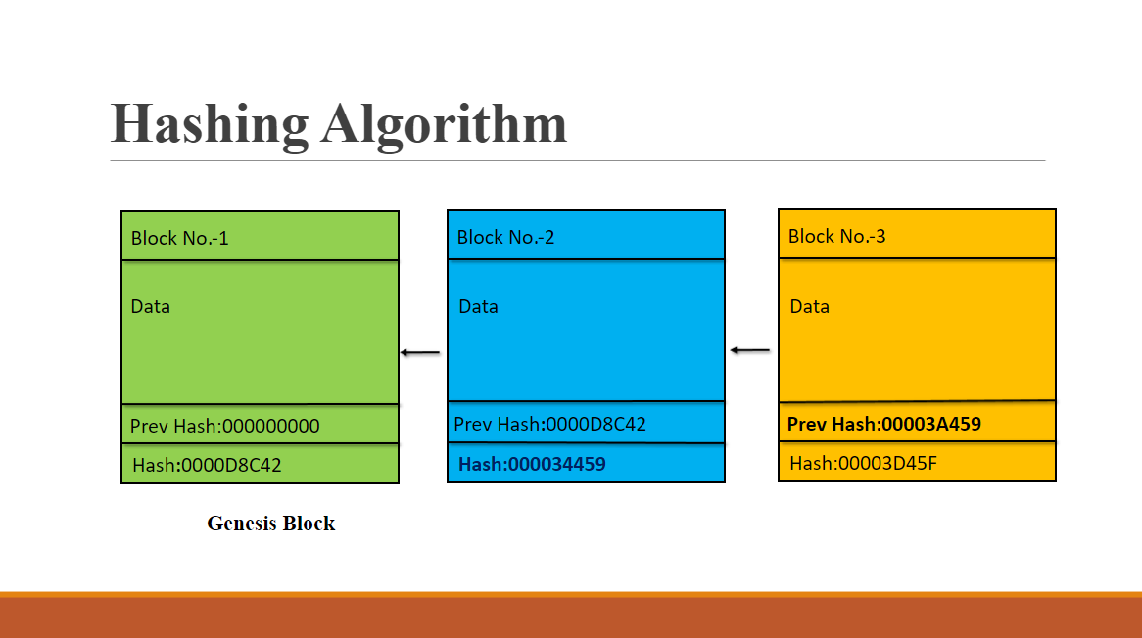
Immutable Ledger
From previous lecture..
Hacker Attacks
Corrupted
A
B
C
D
E
F

Slide 21
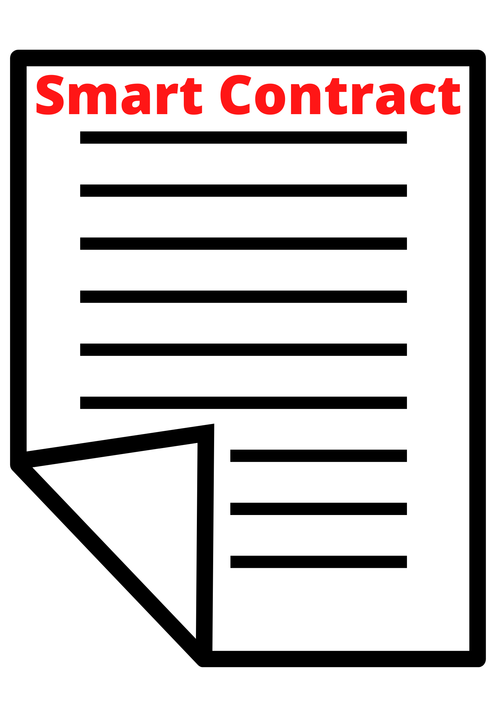
Smart contact
Smart contract are like digital contracts
A blockchain contains smart contract. It is predefine algorithm which determines how data transactions done in blockchain.
Etherium name no blockchain jeno use thay sake che social contract ni madda thi
We have to learn solidity lang for it and we use in our application blockchain
Smart Contract

Slide 22
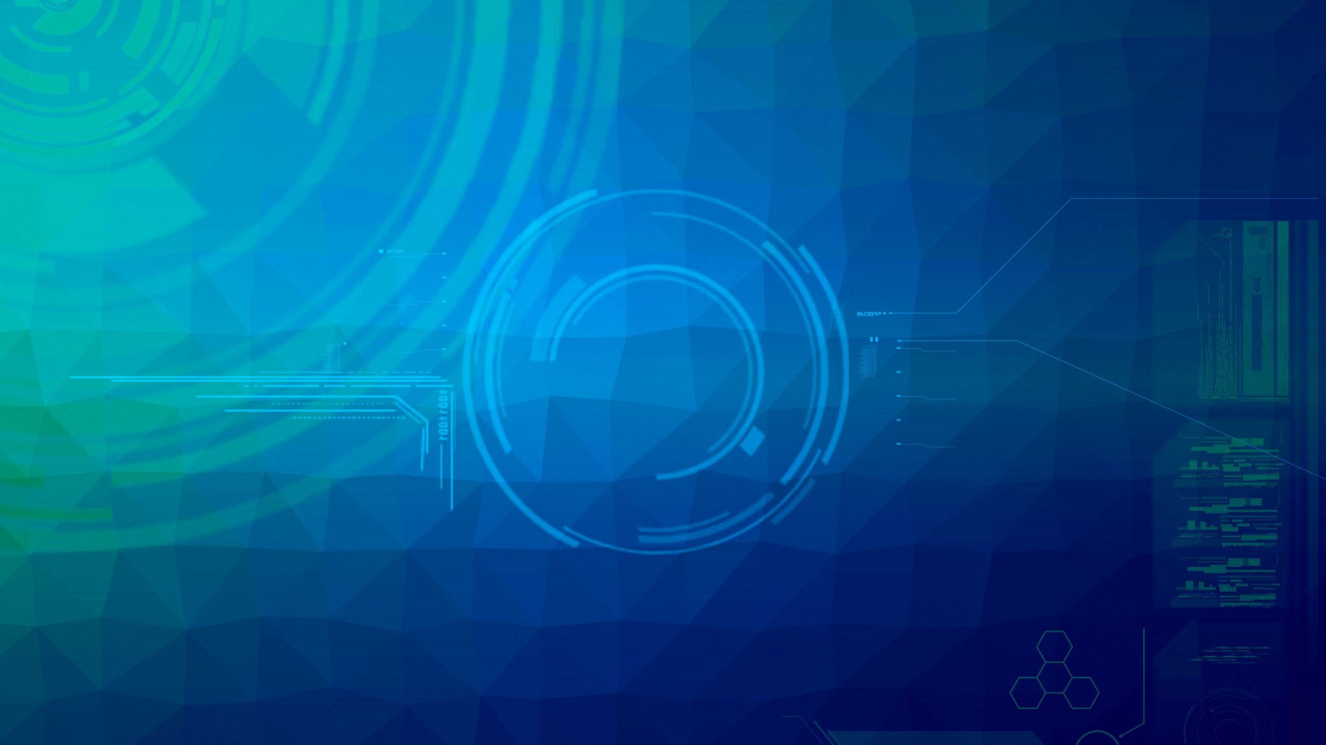
Applications of Blockchain

Slide 23



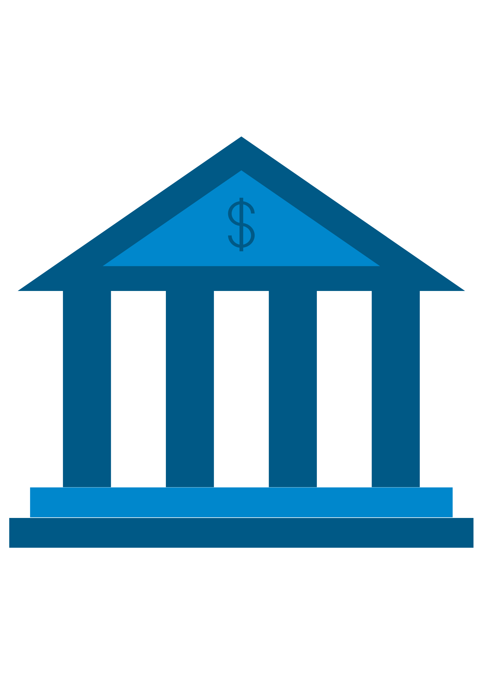
Applications of Blockchain
bitcoin
Healthcare System
Real Estate
International Wire Transfer

Slide 24
Advantages
Trust. Blockchain creates trust between different entities where trust is either nonexistent or unproven. ...
Decentralized structure. Daniel Field. ...
Improved security and privacy. ...
Reduced costs. ...
Speed. ...
Visibility and traceability. ...
Immutability. ...
Individual control of data.

Slide 25
Disadvantages
High implementation costs:
Just as this technology represents low costs for users, unfortunately, it also implies high implementation costs for companies, which delays its mass adoption and implementation. Inefficiency.
Blockchain is not indestructible:
Scalability remains blockchain's weakness. Blockchain entries do not last forever or are not immutable.

Slide 26
Conclusion
Blockchain is a system of recording information in a way that makes it difficult or impossible to change, hack, or cheat the system. A blockchain is essentially a digital ledger of transactions that is duplicated and distributed across the entire network of computer systems on the blockchain.
The Bitcoin is the first successful implementation of blockchain. Today, the world has found applications of blockchain technology in several industries, where the trust without the involvement of a centralized authority is desired.

Slide 27
References
➔https://www.cpajournal.com/
➔ https://www.investopedia.com/
➔https://www.javatpoint.com/
➔https://www.solulab.com/

Slide 28
Thank you

Slide 29
Question?

